Slide 1

New Student Onboarding:
VA & Military Education Benefits
Veterans and Military Certifying Team

Slide 2


Welcome!
We are your School Certifying Officials (SCOs) from the Veterans & Military Certifying Team, located in the Office of the Registrar (OtR) on the main campus.
We want your experience using VA education or military tuition assistance benefits to be as seamless as possible.
Check your OSU email regularly – that’s how we’ll contact you with important updates.
This presentation will guide you through what to expect when using your benefits at OSU.
Disclaimer: The VA makes the final decisions on benefit payments and enrollment.
Have questions? Reach out – we’re here to support you!
GI Bill® is a registered trademark of the U.S. Department of Veterans Affairs (VA). More information about education benefits offered by VA is available at the official U.S. government Web site at https://www.benefits.va.gov/gibill
Notes:
Hello! We are your School Certifying Officials (SCO's). You will find us in the Office of the Registrar (OtR) on the main campus We want your experience using VA education or military tuition assistance benefits to be as seamless as possible. We'll be sending emails to your OSU email account and it is so important that you check it regularly!

Slide 3

AGENDA
Getting Started with VA and Military Benefits
Understanding Your VA Benefits
Certification & Enrollment
Payments & Overpayments
Best Practices and Support

Slide 4








How to Start Using Your VA Education Benefits at OSU
Apply for VA education benefits: https://www.va.gov/education/how-to-apply/
Complete OSU Intake Survey: VA & Military Benefits Intake Survey
Submit Joint Services Transcript for military credit evaluation (if applicable)
Apply for all financial benefits: FAFSA, In-State Tuition , Dependent Tuition Waiver
Register for classes (must meet degree requirements)
Tip: Watch our Registration Guide Videos: https://registrar.oregonstate.edu/va-education-benefits-registration
We automatically submit your VA Certification of Enrollment each term
Email us if you do not want to be certified

Slide 5

OSU Veteran Benefits Forms
Form | Description
Request for In-State Tuition - House Bill 2158 | Application for in-state tuition for veterans with either an honorable discharge or general discharge under honorable conditions.
Dependent Tuition Waiver | Dependents meeting eligibility will receive a waiver for tuition at OSU.
Parent School Letter Request | Allows student to take courses at school other than OSU and receive VA education benefits.
Request for In-State Tuition - Choice Act | Application for in-state tuition for dependents using transferred Post 9/11 GI Bill® benefits, the Fry Scholarship or Dependents Educational Assistance program benefits, or veterans using VRE benefits.
You can access DocuSign forms for:
In-State Tuition Requests
Dependent Tuition Waiver (DTW)
Parent School Letter
Available online at:
https://registrar.oregonstate.edu/forms

Slide 6


Dependent Tuition Waiver (DTW) Eligibility Criteria
Not a VA benefit – the DTW is a state program that waives the cost of tuition only (does not include fees)
Eligibility: Students must meet one of two sets of criteria:
  The student must be a child of a Purple Heart recipient who was relieved or discharged from service in the Armed Forces of the United States with either an honorable discharge or a general discharge under honorable conditions and was awarded the Purple Heart in 2001 or thereafter
    - OR -
  2) The child (includes adopted child or stepchild), spouse, or un-remarried surviving spouse of a member of the United States Armed Forces who:
    Died while on active duty, or
    Died as a result of a military service-connected disability, or
    100% disabled as the result of a military service-connected disability as certified by the Department of Veterans Affairs or any branch of the Armed Forces of the United States.
Residency: Students must be admitted as residents to be eligible.
Age: An eligible child must be age 31 or younger at the time the child applies for the waiver.

Slide 7
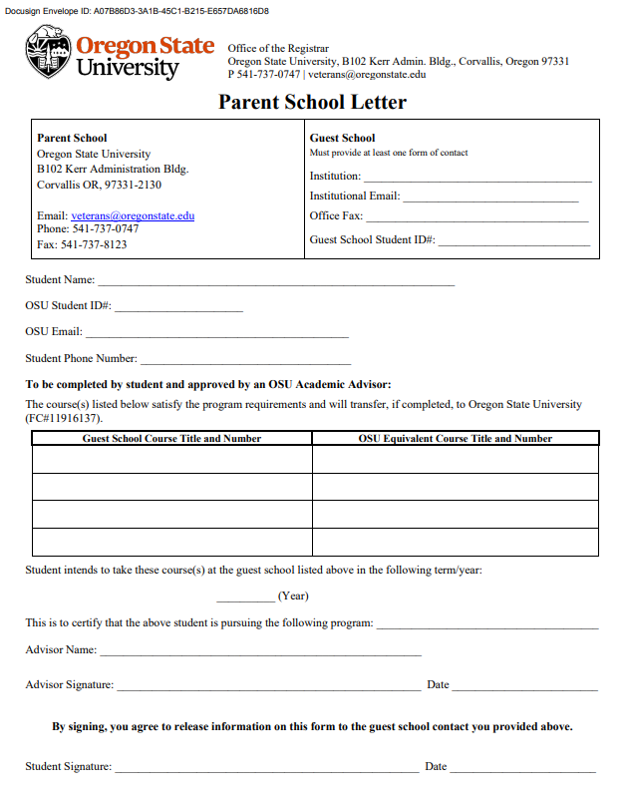
Parent School Letter
The Parent School letter is an online DocuSign form that allows students to take courses at schools other than OSU and use their VA education benefits
Courses must satisfy a degree requirement at OSU
Complete each term you are enrolled at a guest school

Slide 8
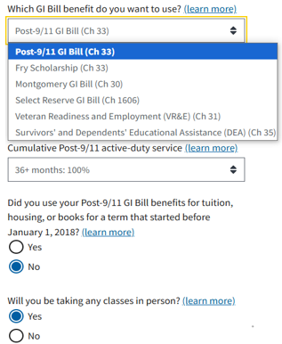


Calculate YOUR VA Benefits
Check the GI Bill® Comparison Tool to estimate your benefits:
Chapter 33 - Post 9/11 GI Bill®
Chapter 35 - Survivors’ and Dependents’ Educational Assistance
Chapter 31 - Veterans’ Readiness and Employment
Chapter 30 - Montgomery GI Bill - Active Duty
Chapter 1606 - Montgomery GI Bill - Selected Reserve
Filter the results by:
GI Bill® Benefit Type
Military or Dependent Status
In person vs online classes
Enrollment Level

Slide 9
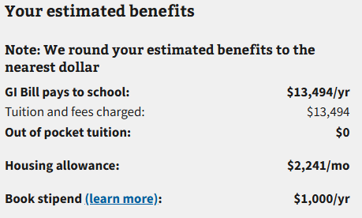

POST 9/11 GI BILL® (CH33) PAYMENTS
*FULL MONTHLY RATES - CORVALLIS CAMPUS
Tuition and fees paid to the school
  Typically arrive around weeks 4 or 5 of the term
Monthly Housing Allowance (MHA) paid to the student when enrolled above ½ time
  7-11 UG credits = Prorated MHA
  12+ UG credits = Full MHA
*Only 1 credit needs to be on-campus to receive the housing allowance based on the campus rate
Book stipend from the VA paid to you
  1000 maximum per year
  $41.67 per credit
  May exhaust in your second term
  https://www.va.gov/education/gi-bill-comparison-tool/institution/11916137

Slide 10
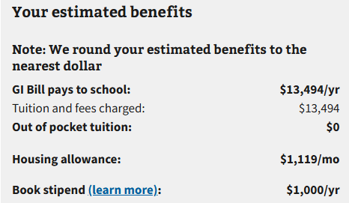
POST 9/11 GI BILL® (CH33) PAYMENTS
*FULL MONTHLY RATES – ALL CLASSES ONLINE
Tuition and fees paid to the school
  Typically arrive around week 4 or 5 of the term
Monthly Housing Allowance (MHA) paid to the student when enrolled above ½ time
  7-11 UG credits = Prorated MHA
  12+ UG credits = Full MHA
* Housing allowance based on 1/2 the National Average when all classes are online
Book stipend from the VA paid to you
  $1000 maximum per year
  $41.67 per credit
  May exhaust in your second term
  https://www.va.gov/education/gi-bill-comparison-tool/institution/11916137

Slide 11


DEPENDENTS EDUCATIONAL ASSISTANCE PROGRAM (CH 35)
DEA benefits are paid directly to you
VA does not pay tuition to the school
Qualified Dependents and Residents of Oregon may apply for the additional Dependent Tuition Waiver
Check the current benefit rates from VA:
https://www.va.gov/family-and-caregiver-benefits/education-and-careers/dependents-education-assistance/rates/
Reminder!

Slide 12
ADDITIONAL BENEFIT RATES
MGIB benefit rates
Military Tuition Assistance
Montgomery GI Bill Selected Reserve
Montgomery GI Bill Active Duty
Montgomery GI Bill $600 Buy-Up program
Federal Tuition Assistance will apply around $166 per quarter credit hour up to FY cap
Visit your installation’s Adult Education Center for assistance
Send approved TA requests to veterans@oregonstate.edu every term!
Oregon National Guard State Tuition Assistance
Questions? Contact the Oregon Army National Guard Education Office:
✉️ ng.or.orarng.list.g1-education@army.mil
📞 (971) 355-4281

Slide 13
ENROLLMENT & MONTHLY BENEFITS
Post 9/11 GI Bill® - Undergraduate Rate of Pursuit
12+ credits = 100%
11 credits = 90%
10 credits = 80%
9 credits = 80%
8 credits = 70%
7 credits = 60%
6 credits and less = no housing allowance
Did you know? The VA uses “Rate of Pursuit” for Post 9/11 GI Bill® and “Training Time” for other chapters to determine your monthly benefit rate
Monthly benefits are prorated when the term starts or ends
You must verify your enrollment at the end of each month (unless VRE / CH 31) even when the term ends before the end of the month!
MGIB & Ch 35/DEA - Undergraduate Training Time
12+ credits = full time
9-11 credits = ¾ time
6-8 credits = ½ time
4-5 credits = less than ½ time
1-3 credits = ¼ time
*Enrollment levels do NOT apply to summer term
Notes:
Monthly benefits are paid according to the number of credits for which you’re registered.
For all VA benefits, your enrollment level is determined according to your registration in classes on each day of the month and will be adjusted if you make registration changes.
These enrollment levels do not apply to summer term and we will send out information about summer term enrollment before summer term begins.

Slide 14
ENROLLMENT & ENTITLEMENT CHARGES
Generally, your entitlement is charged one day for every day of the term when you are full-time. When you are enrolled less than full-time, the VA multiplies your Post 9/11 Rate of Pursuit or your MGIB/DEA training time by the number of days in the term to calculate your entitlement charges.
Post 9/11 GI Bill® -Undergraduate Rate of Pursuit
12+ credits = 100%
11 credits = 90%
10 credits = 80%
9 credits = 80%
8 credits = 70%
7 credits = 60%
6 credits = 50%
5 credits = 40%
4 credits = 30%
3 credits = 30%
2 credits = 20%
1 credit = 10%
MGIB & DEA
- Undergraduate Training Time
12+ credits = full time
* MGIB-AD and DEA are charged ¼ time rate when enrolled less than half-time
9-11 credits = ¾ time
6-8 credits = ½ time
4-5 credits = less than ½ time*
1-3 credits = ¼ time
*Enrollment levels do NOT apply to summer term

Slide 15

EXAMPLE:
VA CERTIFICATION OF ENROLLMENT
STUDENT NAME: BENNY
TYPE OF TRAINING: UNDERGRAD
PROGRAM NAME: FORESTRY
RESIDENT HOURS: 15.0
BEGIN DATE: 2025-09-24
END DATE: 2025-12-12
ONLINE HOURS: 0
*TUITION & FEES (POST 9/11): $5083.88
Notes:
This is an example of the information included in a VA certification. Benny Beaver has been certified under Chapter 33 Post 9/11 GI Bill benefits. He is enrolled as an undergraduate and is seeking a Bachelor of Science in Log Chomping. In fall term he is enrolled in 15 on campus credits and no online credits. The total tuition and fees equal $5083.88.

Slide 16
WHEN WILL I RECEIVE MY MONTHLY BENEFITS?
FALL TERM 2025 (80 DAYS)
9/24/25 – 9/30/25
Paid in October (PRORATED)
10/1/25 – 10/31/25
Paid in November (FULL)
11/1/25 – 11/30/25
Paid in December (FULL)
12/1/25 – 12/12/25
Paid in January (PRORATED)
WINTER TERM 2026 (75 DAYS)
1/5/26 – 1/31/26
Paid in February (PRORATED)
2/1/26 – 2/28/26
Paid in March (FULL)
3/1/26 – 3/20/26
Paid in April (PRORATED)
SPRING TERM 2026 (75 DAYS)
3/30/26 – 3/31/26
Paid in April (2 DAYS)
4/1/26 – 4/30/26
Paid in May (FULL)
5/1/26 – 5/31/26
Paid in June (FULL)
6/1/26 – 6/12/26
Paid in July (PRORATED)
Notes:
The enrollment periods for the 2025-2026 academic year at OSU are shown on this slide. The first period of enrollment is from September 24th to September 30th. The monthly benefit you receive for this period will be paid to you in October and it will be prorated by the VA. The next monthly benefit you receive will be for the enrollment period of October 1st through October 31st and it will be paid in November. You will receive the full monthly benefit because you were enrolled in classes each day of October. When classes end on December 12th, you will receive a prorated payment in January because the VA does not pay benefits between terms.

Slide 17
Tuition Payment Timelines
Chapter Type | Timeline of Payment | Student Account Description | Additional Information
Chapter 33 (Post 9/11 GI Bill) | Weeks 4 or 5 of term | VA CH 33 Payment | You may have a balance on your student account until the VA payment arrives OSU will not impose any penalty (e.g., interest charges, registration holds) due to delayed payment from VA
Chapter 31 (VRE) | Beginning of term | Veterans Chapter 31 Support | Must have a current and valid authorization from VRE Counselor
Chapters 35, 30 and 1606 (DEA and MGIB) | N/A | N/A | Payment plans are available for current students
Dependent Tuition Waiver | Beginning of term | Veteran Dep Tuition Waiver | Adjusted based on enrollment changes Temporary refund or balance may occur until adjustment is completed
Federal Tuition Assistance | Beginning of term | Military Support | FTA must not contain any errors
Oregon National Guard State Tuition Assistance | Varies | OSAC/OR National Guard Tuition | Amount will be adjusted accordingly when FTA is paid at any point during the term

Slide 18
FINANCIAL AID
ADVANCE OF VA FUNDS
You can and should apply for FAFSA!
(Post 9/11 GI Bill® Only)
OSU automatically advances anticipated tuition if you:
  Were Certified, and
  Accepted Financial Aid Award
Why?
  Allows disbursement of financial aid before VA payment arrives
Didn't Happen?
  Email the SCO's
Financial Aid is NOT deducted from the tuition for Chapter 33
Option to sign-up for direct deposit for financial aid refunds
Notes:
You can and you should apply for FAFSA!
Financial Aid is not deducted from tuition for Post 9/11 GI Bill benefits.
If you are expecting a refund of financial aid, you may sign-up for direct deposit through the Office of Student Accounts.
The OSU Advance of VA Funds is specific to Post 9/11 GI Bill students who receive financial aid. OSU will automatically advance the anticipated VA tuition payment if you were certified and accepted your financial aid award before the start the of the term. This is to allow disbursement of financial aid if the advance creates a credit on your student account. The advance will be reversed shortly after it is applied because it is not the actual payment from the VA.
If you did not receive an automatic advance of VA funds, you may email us, and we’ll request a manual advance be added to your account.

Slide 19
POST 9/11 GI BILL® (CH 33): TUITION PAYMENTS
*Paid by the VA
( All payments based on % of entitlement rating)
Not paid by the VA
(including but not limited to)
Tuition
Mandatory Fees
  Student Building Loan/Debt Fee
  Incidental Fee
  Student Health Services
  One-time Matriculation Fee
  Student ID Card (Corvallis Campus)
Degree-Applicable Course fees
UHDS Charges
Parking
Late registration fees
Tuition or fees for courses that are not required for the degree
Non-resident tuition
Tuition paid by Federal or Oregon National Guard State Tuition Assistance, ROTC scholarship, employer program, etc.
*We report $0 in tuition and fees on your initial certification. After the Add/Drop deadline, we amend your certification to report the correct tuition and fee amount.
Notes:
With Post 9/11 GI Bill benefits, the VA will pay the cost of tuition, mandatory fees and course fees according to the percentage of entitlement you were awarded.
Post 9/11 GI Bill benefits do not pay for the cost of University Housing and Dining Services. If you receive a monthly housing allowance, you can use that benefit payment as reimbursement. Additionally, Post 9/11 GI Bill benefits do not pay for parking, late registration fees, tuition or fees for courses that are not required for the degree, or Non-resident tuition.

Slide 20

DEGREE REQUIREMENTS & CERTIFICATION
Courses must satisfy a requirement of your declared Major/Minor/Option, or specific degree requirement to be certified.
What We Do:
  We review your MyDegrees audit
  We email your Academic Advisor if you are registered in lower or upper division elective credit
Important Notes:
  Courses that that have been previously completed with a passing grade will NOT be certified to the VA.
  Extra PAC (Physical Activity Courses) are not certifiable unless your curriculum requires electives to reach 180 credits
Notes:
Courses must satisfy a requirement of your declared major, minor or option in order to be certified.
We review MyDegrees before we certify your enrollment to the VA. If we are unable to determine if a course is meeting a requirement of your degree after checking your MyDegrees, we will email your academic advisor to ask if the course is meeting a requirement of your degree. We will send you an email if you are registered in a course that is not eligible to be certified after we’ve confirmed with your academic advisor. If you remain enrolled in courses that do not satisfy a requirement of your degree, you will not receive VA benefits for those courses.
It’s important to understand that a course that is not certified to the VA does not count towards your enrollment level for VA benefits!

Slide 21
DEGREE REQUIREMENTS & CERTIFICATION (cont.)
We will send you an email if you are registered in a course that is not able to be certified after we’ve confirmed with your academic advisor.
If you are enrolled in the University Exploratory Studies Program, only the courses that satisfy the Baccalaureate Core or Core Ed can be certified (limited exceptions can apply).
If you remain enrolled in courses that do not satisfy a requirement of your degree, you will not receive VA benefits for those courses.
It’s important to understand that a course that is not certified to the VA does not count towards your enrollment level for VA benefits!

Slide 22

MAIN CAUSES OF OVERPAYMENTS
WITHDRAWAL
UNSATISFACTORY (“U”)

Slide 23
AVOIDING OVERPAYMENTS: KEY FACTORS
Course withdrawals and “U” grades lead to overpayments
A course is considered withdrawn if it is dropped after the last day to drop a class with a 100% refund
The VA may request that you repay all tuition, housing, and book payments that you received for the course
If you think you need to withdraw from a course because of extenuating circumstances, please contact our office first

Slide 24

BEST PRACTICES
Check your OSU Email!
  We’ll notify you when we begin certifying benefits and if there are any courses we can’t certify.
Register Early
  Sign up for classes as soon as your priority registration slot opens. Early registration helps us resolve any certification issues quickly.
Limit Changes
  Try to finalize your schedule on or before the first day of term. Changes after the add/drop deadline may lead to overpayments.
4. Reach Out
  Questions? Contact us, Willie Elfering, your academic advisor, your instructor, or other campus support services.
Notes:
These are the best practices to keep you on track while you are using VA benefits at OSU:
Check your OSU email account regularly for emails from our office. We will let you know when we are going to begin certifying benefits and if there is a course that we are not able to certify.
Register for courses as soon as your priority registration timeslot opens. This allows us time to problem-solve any issues that may come up during certification. The sooner you are registered for courses, the sooner you will be certified.
You all will have Veterans Priority Registration at OSU, which means that you are assigned a registration date and time based on your class standing and Veterans status.
Limit registration changes. If you need to add or drop a class, try to make registration changes ON or BEFORE first day of term, if possible. If you make registration changes after the end of the add/drop period, you may have to repay benefits for the withdrawn course(s) to the VA and/or OSU.
Reach out if you have questions or need help. You can reach out to us, Willie, your academic advisor, your instructor, or other supports on campus.

Slide 25

WE ARE HERE FOR YOU
Veterans and Military Certifying Team
Email: veterans@oregonstate.edu
Phone: 541-737-0747
Office: B102 Kerr Admin Bldg
(M-F 10:00 a.m. – 4:30 p.m.)
Notes:
We want you to know that we are here for you! We look forward to working with you!

